Slide 1

WEBINAR PRESENTATION
SLIDES TEMPLATE
Go to File → Make a copy to get your own editable copy.

Slide 2
STARTING SOON:
[WEBINAR TITLE HERE]
This slide will be displayed before you go live.

Slide 3
[WEBINAR TITLE HERE]
Add your name/presenters here if you like

Slide 4
[DISCLAIMER]
Add any relevant disclaimer here.

Slide 5
How Beginners Can Start A Data Science Career Without Confusion
Learn the exact roadmap, skills, and projects required to become a job-ready Data Scientist.

Slide 6
And this is going to allow you to:
List a series of benefits here
-Finally achieve _____________ without _______________--
-(and everything that would mean to them, and their emotions)
-Connect with people’s emotions/feeling!

Slide 7
And you’ll want to make sure you stay until the end...
At the end, I’m giving out a: (give a gift/incentive to stay until the end)
-Free cheat-sheet that wraps up the methods we’ll be talking about today
-A free case study explaining…
-A free item that I’ll send to you in the mail…
-Get creative. What would make you say “wow, I should stay until the end for that!”

Slide 8
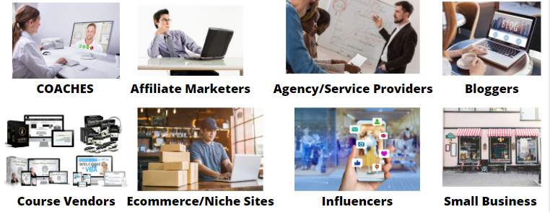
Who is this webinar presentation for?
Make a list of people who this is for. Try to include anyone relevant but don’t over-stretch it. Include images if you like- you could also do an individual slide per type of person.

Slide 9
Who am I and why should you listen to me?
Take this slide to give an overview of yourself.
A nice photo, highlight what you are best known for (expert at ___) highlight 1-2 authoritative points about yourself (coached 25 people to losing 50 lbs), (have done millions in sales online), then include 1-2 humanizing points that show you’re relatable.

Slide 10
Start a quick, short story of yourself here. Part 1
Start explaining a very relatable story here to your customer avatar. Go back to when you were in their shoes and facing the same problem they are currently facing.
Then, explain how you dealt with the same challenges trying to solve that problem as them, and explain the emotional pain you felt. Include the same issues they faced i.e. bad coaches/mentors, following methods that didn’t work, etc.
“Type a 1 in the chatbot if you know what I’m talking about”...wow, lots of 1’s...
Be authentic. The honesty will shine through to your webinar attendee. Show them that you felt the same emotional pain they are feeling right now. This will show them that you “get it”.

Slide 11
Story Part 2: You’re their hero
(and them, once they solve their problem)
Now, explain how you triumphed over the problem you faced (the same one they are facing now)
Then explain how the route you took to solve it was what finally worked, and that’s what you are going to be talking about today...which is why they are in the right place

Slide 12
Story Part 3: Building Authority and Trust
Now, explain a bit about where you are today, now that you've solved the problem you love helping others do the same.
From there, share some authority to show you are recognized by others as an expert now as well to further back up your story. I.E. featured on certain podcasts, blogs, media, speaking in the past, customer testimonials… (without explaining you’re selling anything just yet).
I.E. “And now I am passionate about helping others also lose weight...like Julia, who with my help, lost 50 lbs using the things we’re going to be talking about today.

Slide 13
Story Part 4: Results, results, results!
Keep showing them results you’ve gotten for people.
(Don’t explain anything about a program or anything you’re selling- right now we’re just showing them that you are someone who went through all their pains and now help people just like them solve the same problem they face-
Leading them to see that you are the ideal person they can:
Trust
Knows exactly how to help them solve their painful problem

Slide 14
A Note About Your Story
(this slide is just a note to you)
Note, you can take as many slides as you need for your story. Try to keep it as short as possible, simply to explain that you were where they once were, and now you’ve overcome the problem they are still facing.

Slide 15
So now, I’m sure you see why I’m so excited to share all of this with you!
So now, type a “1” in the chatbot if you’re ready to dive in, so I can show you how I ____________….
“Awesome! Lots of ones coming in! Let’s dive in…”

Slide 16
My Goals For You Today
Discover my method for ______________________-
Give you the “under the hood” look at how you can implement these steps to help you join in on _______________
Set the stage for helping them discover your highly valuable information (solve their painful problem) and how it will also be able to be directly applied to them.

Slide 17
The Right Roadmap To Become A Data Scientist

Slide 18
How To Build Real-World Projects That Impress Recruiters

Slide 19
A few slides about secret #1.
Try to focus on building trust, excitement, validation of your particular solution as the BEST solution that works fast, easier than others, etc. Leverage storytelling, humor, and personality if you can.

Slide 20
3 Secrets To (Main Topic of Webinar/Problem To Solve)
The Industry-Approved Learning Roadmap
The Project Strategy Used By Successful Data Scientists
The Career Strategy To Get Data Science Opportunities

Slide 21
How To Prepare For Data Science Jobs & Interviews

Slide 22
A few slides about secret #2.
Try to focus on building trust, excitement, validation of your particular solution as the BEST solution that works fast, easier than others, etc. Leverage storytelling, humor, and personality if you can.

Slide 23
3 Secrets To (Main Topic of Webinar/Problem To Solve)
Secret #1: (Secret should make them super excited about why your solution is the best solution, better than the others, or some true value).
Secret #2: (Another awesome piece of discovery- try to go for a combination of discovery/validating your concept).

Slide 24
join My Data Science Career Accelerator Program Includes: Python SQL Machine Learning Projects Resume Building Interview Preparation Career Support

Slide 25
A few slides about secret #3.
Try to teach something here. You don’t have to go crazy. If you’re pitching a done for you service, you can give them the overview of the process, so later you can pitch “so now you can do it all yourself, or… have me do it”
Teaching a bit to give value and make them feel excited/like they learned something, will establish trust, excitement, familiarity and belief in you as a teacher

Slide 26
3 Secrets To (Main Topic of Webinar/Problem To Solve)
Secret #1: (Secret should make them super excited about why your solution is the best solution, better than the others, or some true value).
Secret #2: (Another awesome piece of discovery- try to go for a combination of discovery/validating your concept).
Secret #3: Discovery + teaching (show them some value so they actually get something from the call- share one of your methods, go for value+ showing them that you are knowledgeable and a capable teacher).

Slide 27
5: Bonuses Data Science Roadmap PDF Interview Questions Cheat Sheet Project Ideas Guide Resume Templa

Slide 28
Transition to Pitch (A few options)
Option 1: So what I’ve taught you on this call will let you get to (some level of result). If you want to (achieve said result faster, easier, without having to do the work yourself).... Then you might be very interested in a brand new (course/program/done for you service I’ve put together)... Introducing…
Option 2: (Works great if selling done for you) So now you see the whole process...and you have two choices. You can do all of this yourself…
Option 3: So what I’ve taught you on this call will let you get to (some level of result). If you want to (achieve said result faster, easier, without having to do the work yourself).... Then you might be very interested in a brand new (course/program/done for you service I’ve put together)... Introducing…

Slide 29
Introducing...
[PRODUCT /SERVICE REVEAL/ IMAGE HERE]

Slide 30
In a Nutshell, [ITEM FOR SALE] Will Let You:
[LIST OF WHAT IT WILL DO FOR THEM - PROBLEMS IT SOLVES AND HOW IT DOES SO BETTER THAN ANYTHING ELSE]
(Item) is designed to help you (desired outcome) in (time frame) with/without (good or bad thing)

Slide 31
What That Means For You Is:
[LIST OF WHAT IT MEAN FOR THEM- EMOTIONALLY. MORE RELIEF FROM ____, ETC.]

Slide 32
More Specifically, Here’s What’s Included:
(Type of product): Video course, E-book, program, coaching, done for you.. Etc, explain exactly what they get in the main item.
(Supporting Items): What else are you including (note, make room for bonuses later)...this should still be something part of the main product. EG. accompanying checklists, homework lessons, PDF or powerpoint transcripts, even things like a FB group etc.
Use images to help increase the perceived value where possible. You can have images made easily at www.fiverr.com.

Slide 33
(Item for sale) Helps You Finally (Solve Problem) Once and for All Without (Previous Issues)
If you offer Mentorship:
Data Science Career Mentorship Program Helps You Finally Build A Clear Path To Become A Job-Ready Data Scientist Without Wasting Time Learning Random Topics.

Slide 34
Quick reminder of how what’s in there helped you
You now have the roadmap, skills direction, and practical strategies needed to start your Data Science journey with confidence.

Slide 35
Don’t Just Take My Word For it:
Testimonials- list of people who have benefitted from your program
Here is where you want to give the attendee some FOMO-
Show results people have gotten with your help
As opposed to earlier on , here you can show specific testimonials of what people have to say about your program and how it helped them, and them endorsing others jumping on board
Character testimonials- perhaps you only have some testimonials of people saying nice things about you as a person or working with you in general- or testimonials from other programs. You can include these last in this section- just as some additional reinforcement that you care, and are trustworthy, as proven by others claiming so.

Slide 36
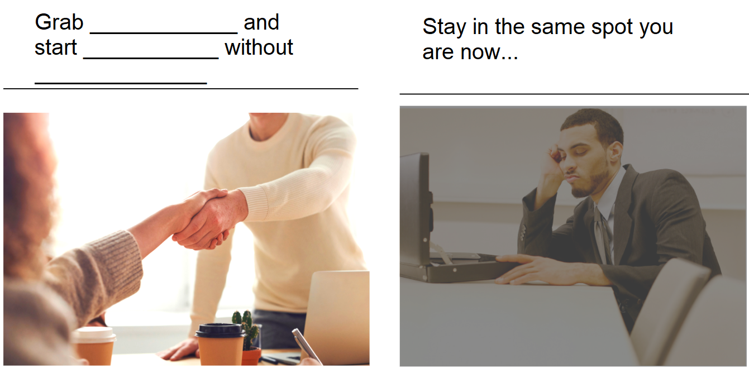
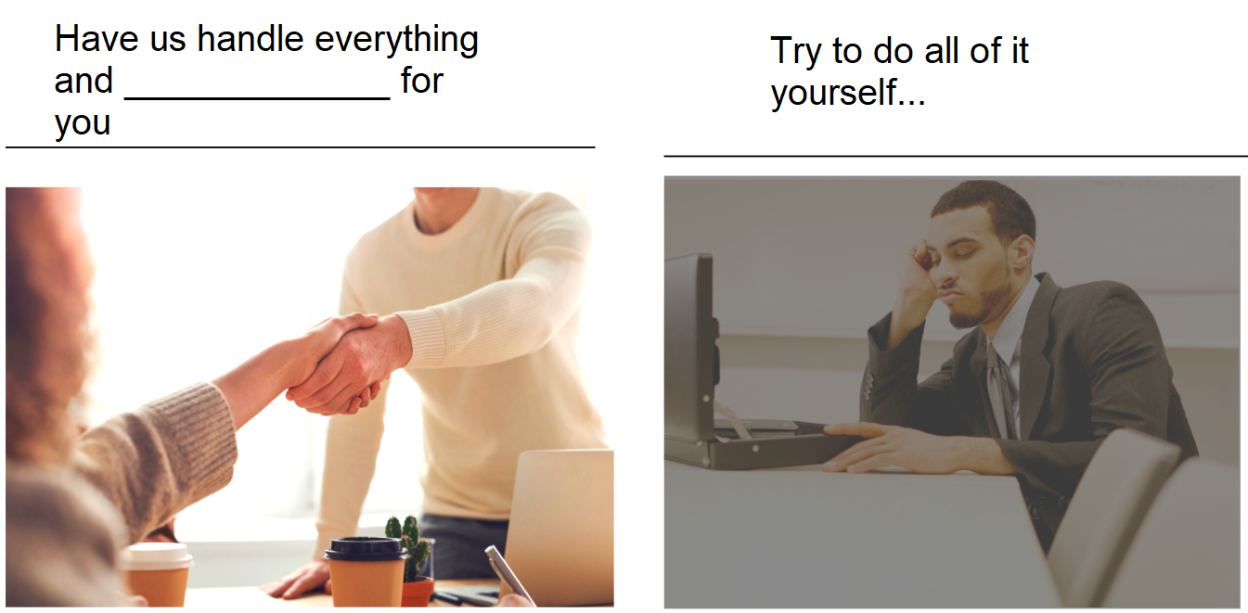
Now, You Have Two Choices...
Program/course example
Done for you/services example

Slide 37
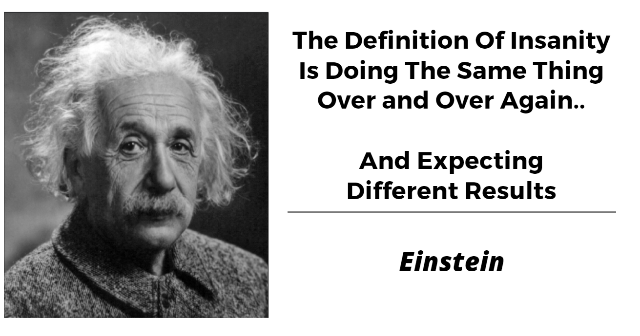
Include A Quote Slide If You Like

Slide 38
And You’re Backed By My Guarantee...
Come up with a realistic guarantee.
It can be a money back guarantee, a “get a certain result by a certain time or money back guarantee”, or “if you don’t get this result we’ll go in and do it for you.”
Be realistic, be ethical, and make sure you’re doing something legal. However, try to make it compelling to the point where someone feels very little risk taking this leap with you.

Slide 39
So To Sum Up Everything...
Item 1………………………………….$997 Value
Item 2………………………………….$997 Value
Item 3………………………………….$997 Value
Item 4………………………………….$997 Value
Item 5………………………………….$997 Value

Slide 40
Real World Value: $X,XXX
If all this did for you was…. __________________ , you can see how $X,XXX is a steal.
However, I won’t be charging you anywhere near that.
Ways to explain discount (come up with an authentic honest reason, that will resonate! Don’t use a eye-rolling reason).
One idea: “have you heard of case study/testimonial pricing? I’ll be offering an extreme discount to anyone who offers to be a case study of results for me and give me an honest testimonial. That means you let me use your results as an example. It’s a win-win. I get some more proof that I know how to help people, and you get a discount. Sound fair?
Another idea: “I don’t feel comfortable charging you that”, “I want this to be affordable to you”, Honestly think about a real reason you want to discount- make it a “win-win” type scenario.

Slide 41
LIVE DEMO/OVER THE SHOULDER
If it applies to your product, show them an over the shoulder demo of your product or the method you’re teaching.
For example, one of our webinars is a Pinterest marketing webinar. Many people wonder “is my niche even on Pinterest?” We did a segment going live on the webinar to Pinterest, and asking everyone to give us a niche. We took them one by one showing them that their niche AND competitors were there. It left everyone excited and turned all non-believers to “wow, I need this!”

Slide 42
Before I Announce The Final [CASE STUDY/DISCOUNTED ETC.] PRICING…
What else do you need to succeed with [PROGRAM/ITEM]?

Slide 43
FAST ACTION BONUSES
Bonus 1: Data Science Career Roadmap PDF
Beginner Job-ready Data Scientist complete learning path.
Bonus 2: Data Science Interview Preparation Kit
Python, SQL, Machine Learning interview questions and preparation tips.
Bonus 3: Industry Project Ideas Guide
Resume- add real-world Data Science project ideas.
Bonus 4: Data Science Resume Template
Recruiter-friendly resume structure.
Bonus 5: Personal Career Guidance Session (offer)
Learning path career direction guidance.

Slide 44
FAST ACTION BONUSES (stacking page)
(after announcing each bonus, you’ll stack it)
BONUS #1: (Objection crushing Bonus- give them something that increases perceived value but also tries to crush one of their objections. For example- they feel they will not get support- offer a free coaching call, support group, etc.)

Slide 45
FAST ACTION BONUSES
BONUS #2:
(Objection crushing Bonus- give them something that increases perceived value but also tries to crush one of their objections. For example- they feel they will not get support- offer a free coaching call, support group, etc.)

Slide 46
FAST ACTION BONUSES (stacking page)
(after announcing each bonus, you’ll stack it)
BONUS #1: (Objection crushing Bonus- give them something that increases perceived value but also tries to crush one of their objections. For example- they feel they will not get support- offer a free coaching call, support group, etc.)
BONUS #2: (Objection crushing Bonus- give them something that increases perceived value but also tries to crush one of their objections. For example- they feel they will not get support- offer a free coaching call, support group, etc.)

Slide 47
FAST ACTION BONUSES
BONUS #3:
(Objection crushing Bonus- give them something that increases perceived value but also tries to crush one of their objections. For example- they feel they will not get support- offer a free coaching call, support group, etc.)

Slide 48
FAST ACTION BONUSES (stacking page)
(after announcing each bonus, you’ll stack it)
BONUS #1: (Objection crushing Bonus- give them something that increases perceived value but also tries to crush one of their objections. For example- they feel they will not get support- offer a free coaching call, support group, etc.)
BONUS #2: (Objection crushing Bonus- give them something that increases perceived value but also tries to crush one of their objections. For example- they feel they will not get support- offer a free coaching call, support group, etc.)
BONUS #3: (Objection crushing Bonus- give them something that increases perceived value but also tries to crush one of their objections. For example- they feel they will not get support- offer a free coaching call, support group, etc.)

Slide 49
So Here’s Everything You Get… (Final stack slide)
Put these each on an individual slide, so it looks like you’re “stacking” value on top and make them feel like it just keeps getting better and better.
Main Product/Service Part 1……………………………………. $XXX value
Main Product/Service Part 2……………………………………. $XXX value
Main Product/Service Part 3……………………………………. $XXX value
Main Product/Service Part 1……………………………………. $XXX value
Objection Crushing/Value Adding Bonus #1………….………. $XXX value
Objection Crushing/Value Adding Bonus #2.…………………. $XXX value
Objection Crushing/Value Adding Bonus #3.…………………. $XXX value

Slide 50
So Here’s Everything You Get… (Final stack slide)
Actual Read World Value: $XX,XXX (be real!)
Put these each on an individual slide, so it looks like you’re “stacking” value on top and make them feel like it just keeps getting better and better.
Main Product/Service Part 1……………………………………. $XXX value
Main Product/Service Part 2……………………………………. $XXX value
Main Product/Service Part 3……………………………………. $XXX value
Main Product/Service Part 1……………………………………. $XXX value
Objection Crushing/Value Adding Bonus #1………….………. $XXX value
Objection Crushing/Value Adding Bonus #2.…………………. $XXX value
Objection Crushing/Value Adding Bonus #3.…………………. $XXX value

Slide 51
(Deciding Your Deal)
One tactic is to use a webinar timer (you can embed a youtube timer video into a Google slide deck). Give a webinar-only price and offer stack that expires at the end of the timer.
Another option is to LINK to a page with a timer on it for a deal that expires in a few days,a week, month, etc.
Or, you can just link to a book a call page, or offer page without any sort of urgency or scarcity. The main focus is to make the OFFER so good that it works regardless of the need for urgency or scarcity- however, adding these if possible could really increase your conversions. Just make sure your offer is as amazing as it can be first.

Slide 52
Another Idea
One more idea is to show them your website and that your website price is higher than what this webinar deal is. Explain that since they took action to show up for your webinar, the webinar attendee deal is better than your website (add urgency if you like).

Slide 53
Special Webinar Deal
$XX,XXX
$XXX or $XXXX
http://yourlink.com/deal

Slide 54
Reminder: Everything You’re Getting:
Recap the offer
>> Grab (Item) Here: http://yourlink.com/deal <<

Slide 55
Everything This Will Do For You:
Recap the emotional benefits/how this will relieve pain
>> Grab (Item) Here: http://yourlink.com/deal <<

Slide 56
Reminder of results for others/let them taste it
Remind them what this has done for you and others, and how very soon they can join you and the others that already did what they want to do.
>> Grab (Item) Here: http://yourlink.com/deal <<

Slide 57
Final Slide -Offer Slide NOTES
The final slide of your webinar will be the offer slide.
What we like to do is have the offer there and any urgency (like a timer), any guarantees, etc. Put it all there.
Leave this slide up for the remaining duration of the webinar.
Now, take questions, Read the answers out loud. If doing pre-recorded, do a list of the frequently asked questions/ all questions you can think of, of any objection-creating questions. Stomp as many objections/be as trusting and open as you can. Close the webinar when you’re done with questions and remind them when the offer ends. If you wish, give them a way to personally follow up with you.

Slide 58
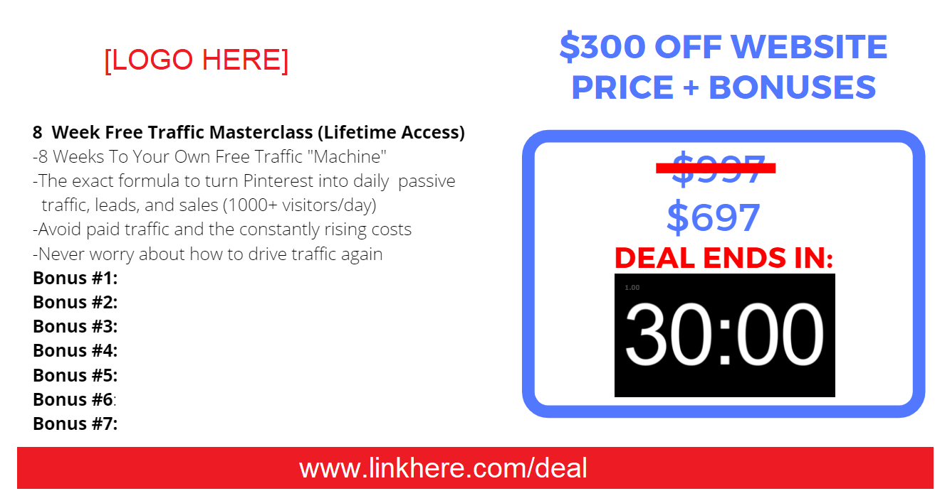
Timer Example Webinar Offer Slide

Slide 59
YOU DID IT!
GO MAKE SOME SALES :)

